Slide 1
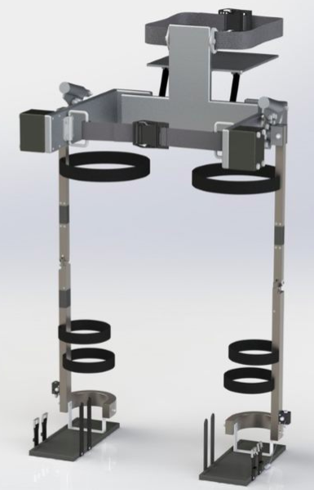
Ex.IO: A Weight-Assist Exoskeleton
Group 11: Matthew Choi, Jennifer Nguyen, Huong Pham, Sharon Tam, Megan Vandermolen

Slide 2
Outline
Problem & Aim
Current available exoskeletons
Design Criteria
Restrictions
Hip Sub-system
Thigh and Shank sub-systems
Knee Sub-system
Ankle Sub-system
Kinetic & Kinematic results
Parameterization
Future Work
Conclusion

Slide 3
Introduction
Design Criteria
Design
Discussion & Next Steps
Results
Problem
Infantry soldiers carry heavy loads for a prolonged period, which may decrease performance and increase chances of injuries
Aim
Design a passively powered lower-limb exoskeleton capable of transferring backpack load to the ground; hence, improving walking endurance and mission performance.
Notes:
Problem
- Infantry soldiers carry increasing heavy loads for prolonged periods during mission, which has been shown to decrease mission performance and increase the number of injuries
AIM
- The aim of this project is to design a passively-powered hip-knee-ankle-foot exoskeleton which transfers soldier’s backpack load to the ground. This should result in improved walking endurance, lower fatigue and a reduction in the number of overuse injuries

Slide 4
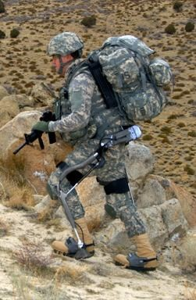
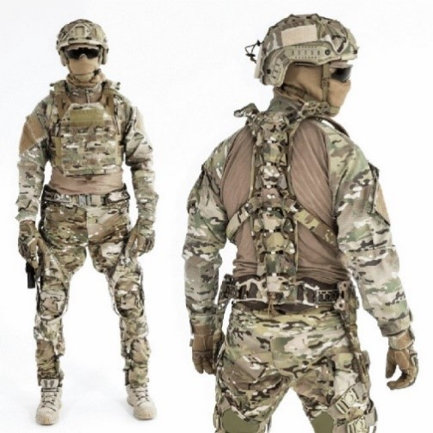
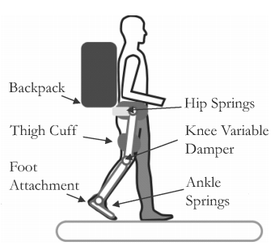
Introduction
Design Criteria
Design
Discussion & Next Steps
Results
Current Exoskeletons
[1]
HULC
Active
Made by Lockheed Martin
Carry a load up to 36 Kg
Mawashi Tactical Exoskeleton
Passive
Spans from torso all the way to ankle
MIT Exoskeletons
Quasi-passive
Transfer 80% of 36 Kg to ground
[2]
[3]

Slide 5
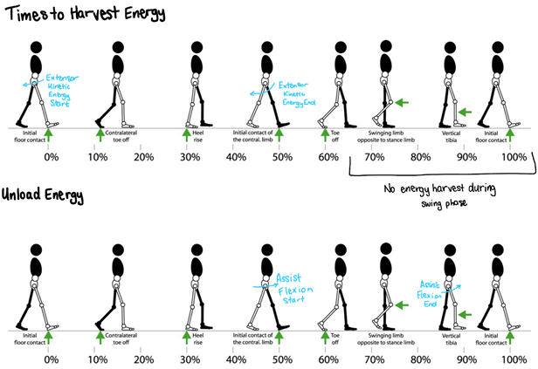
Introduction
Design Criteria
Design
Discussion & Next Steps
Results
Design Criteria
System will harvest & restore energy from gait (Passively powered)
Increase load carrying capacity & walking endurance
Durable
Comfortable
Safe & reliable
Notes:
System will harvest & restore energy from gait (Passively powered)
Increase load carrying capacity & walking endurance
Durable
Comfortable
Safe & reliable

Slide 6
Introduction
Design Criteria
Design
Discussion & Next Steps
Results
Restrictions
Made for male and female infantry soldiers , aged 21-25
Minimum 50% reduction carried weight
Maximum Backpack weight : 50 Kg
Maximum Exoskeleton weight : 25 kg
Assist 10% of hip flexion moment
Height limited to 153.5 cm to 187 cm
Allow 95 % range of motion
Notes:
Our exoskeleton is
Made for male and female infantry soldiers , aged 21-25
It will provide
Minimum reduction in the GRFs due to the carried weight by 50%
Backpack weight is restricted to 50 kg based in literature.
The maximum exoskeleton mass should be no more than 25 kg.
The exoskeleton will assist 10% of hip flexion.
User height is restricted to 153.5 – 187 cm
The exoskeleton will limit ROM to 95 % where possible

Slide 7
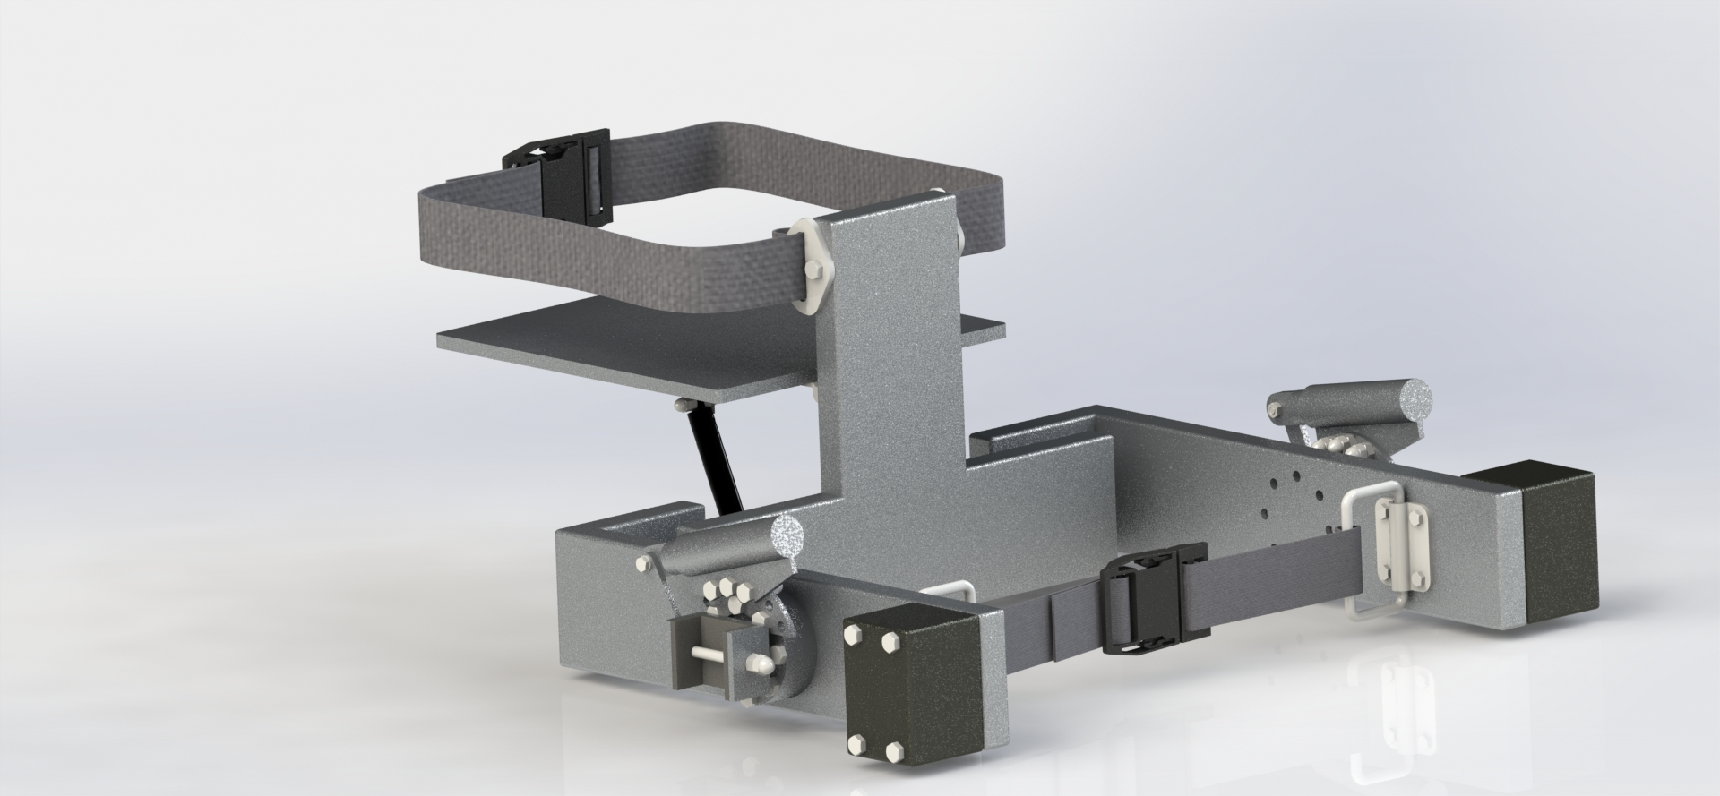
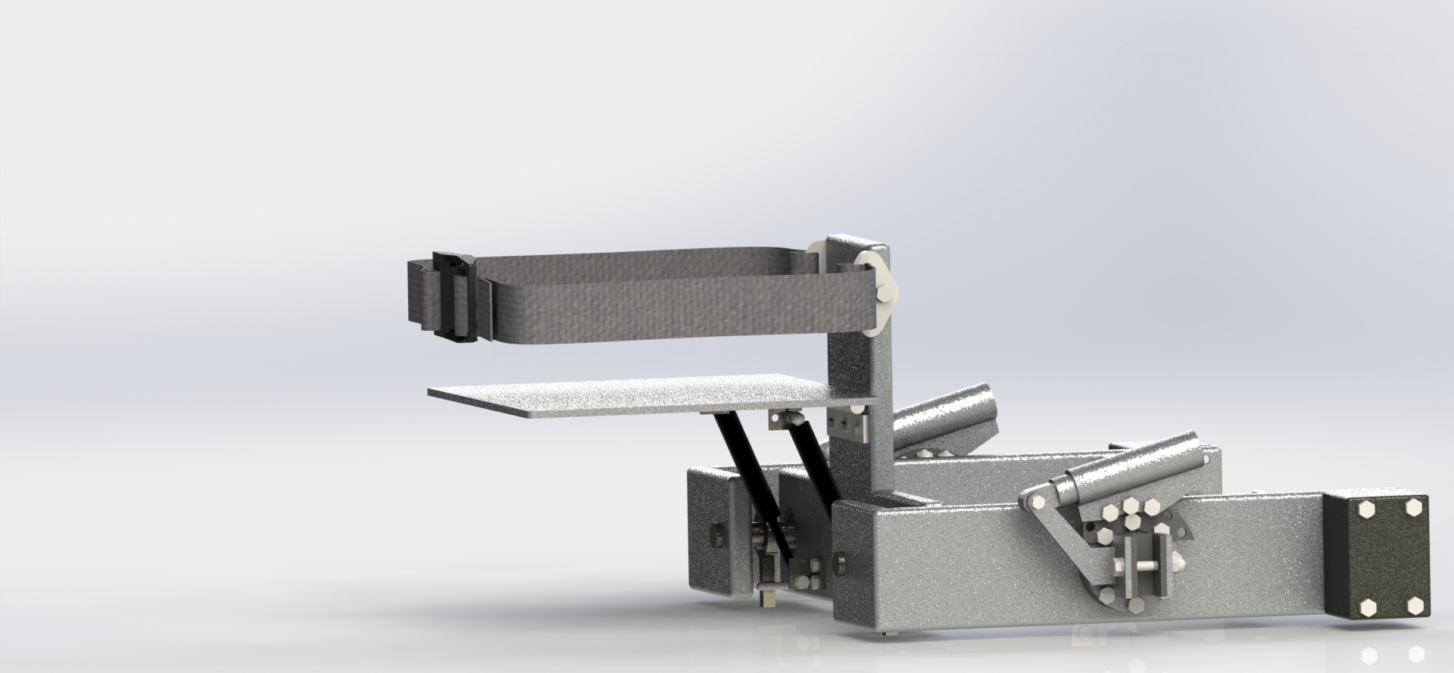
Introduction
Design Criteria
Design
Discussion & Next Steps
Results
Hip Subsystem
Primarily made from Aluminum alloys ( 1100-0 and 1024-0)
2 DOFs: Extension/Flexion and Abduction/Adduction
Flexion assist only
Free range of motion at for hip abduction

Slide 8
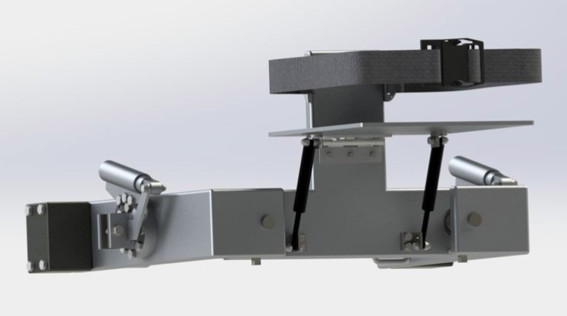
Introduction
Design Criteria
Design
Discussion & Next Steps
Results
Notes:
Add animations or slides to show each render larger while you talk about it

Slide 9
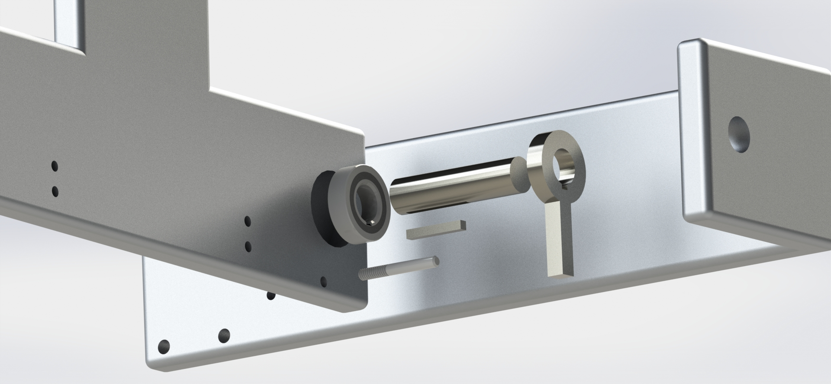
Introduction
Design Criteria
Design
Discussion & Next Steps
Results
Notes:
Add animations or slides to show each render larger while you talk about it

Slide 10
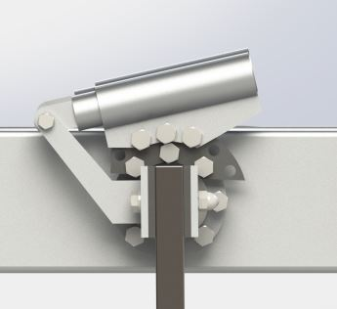
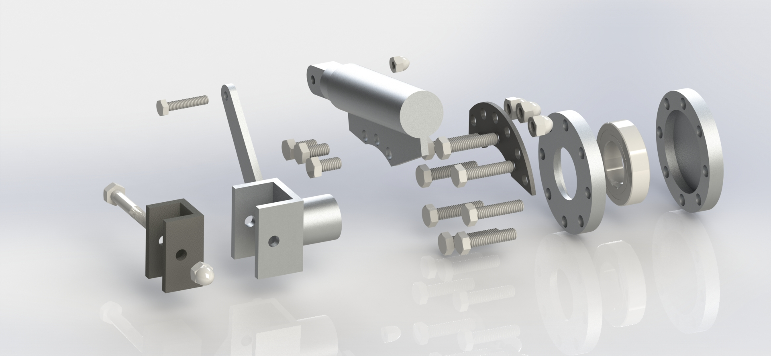
Introduction
Design Criteria
Design
Discussion & Next Steps
Results
Notes:
Remove details

Slide 11
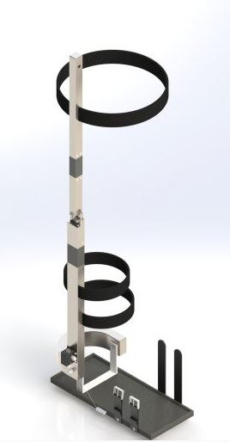
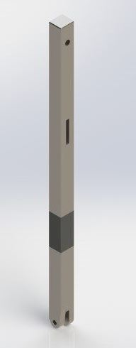
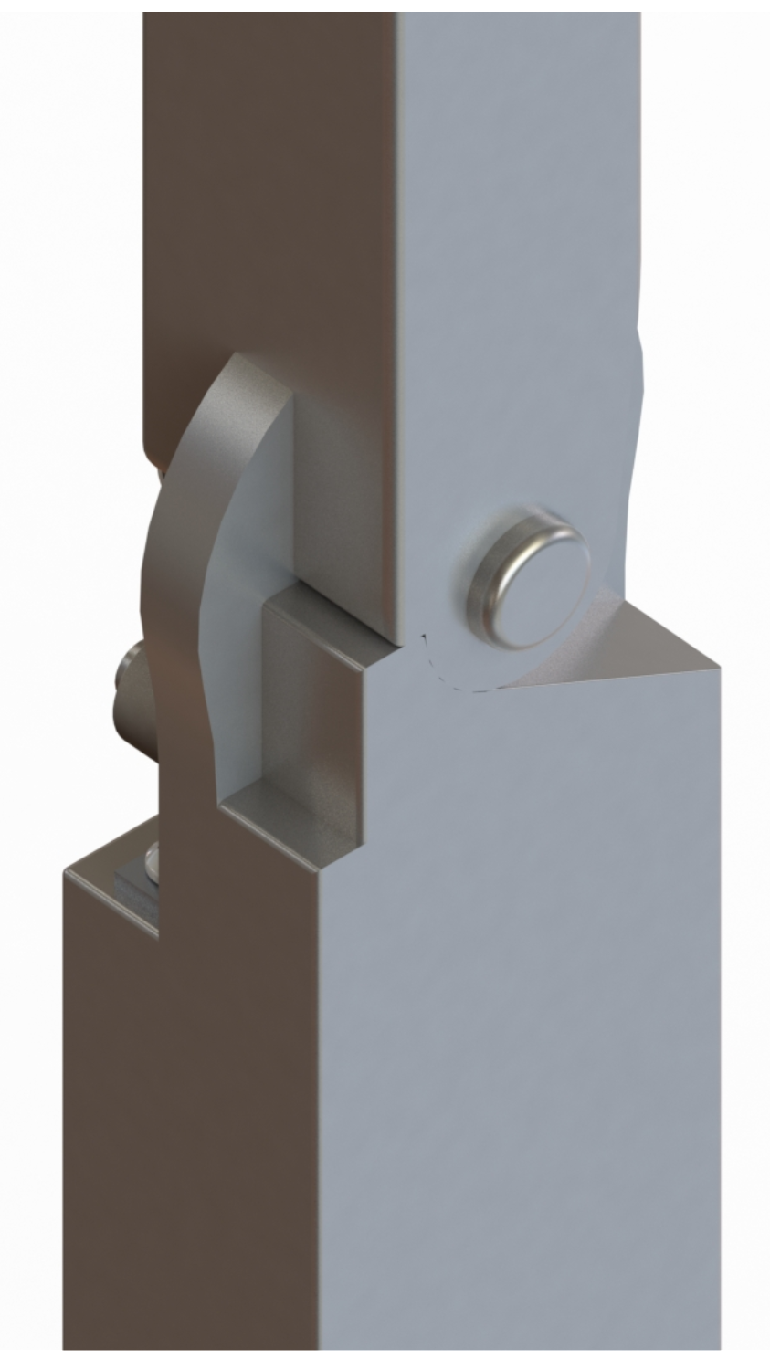
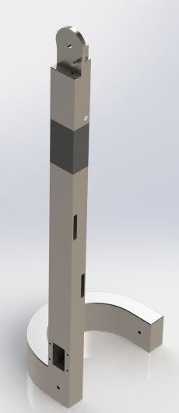
Introduction
Design Criteria
Design
Discussion & Next Steps
Results
Thigh and Shank Subsystem
Thigh:
Foam damper
Pin joint connection to hip
Hard stop feature
Shank:
Shank Ubar wraps around back of lower calf
Attach to Ubar of foot by pin joint

Slide 12
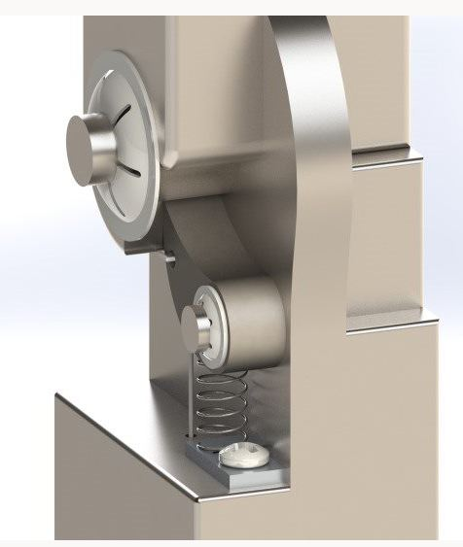
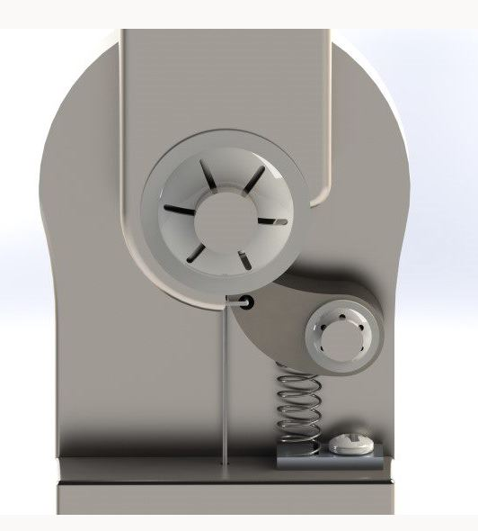
Introduction
Design Criteria
Design
Discussion & Next Steps
Results
Knee Subsystem
Pawl:
Made of 1040 steel
Stance control to help counter-act horizontal forces at the knee
String redirection above ankle:
Helps redirect string smoothly to foot attachment site
Notes:
Ratchet built into the thigh
Pawl made of 1040 steel & attached to shank
Locked during stance phase, unlocks at toe off for swing phase
String attached to the pawl, runs through the shank to the foot.
Foot unlocks the knee at full plantar flexion.

Slide 13
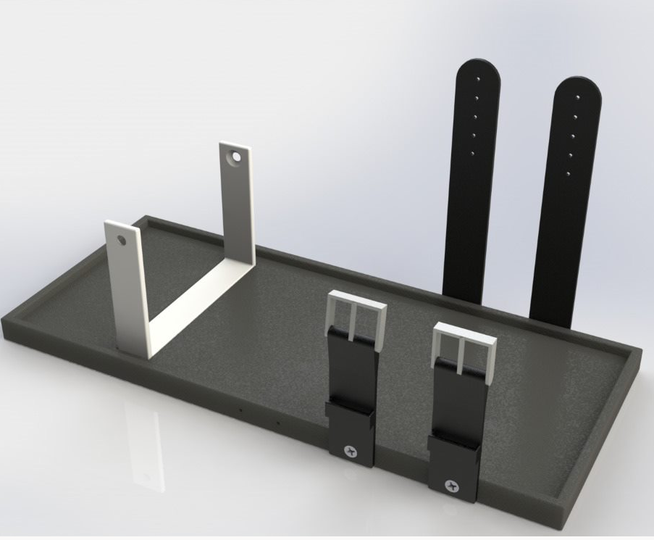
Introduction
Design Criteria
Design
Discussion & Next Steps
Results
Ankle Subsystem
1 DOF – plantarflexion & dorsiflexion
Compliant boot as foot attachment
Secure to user’s boot with buckles
Transfer load to ground

Slide 14
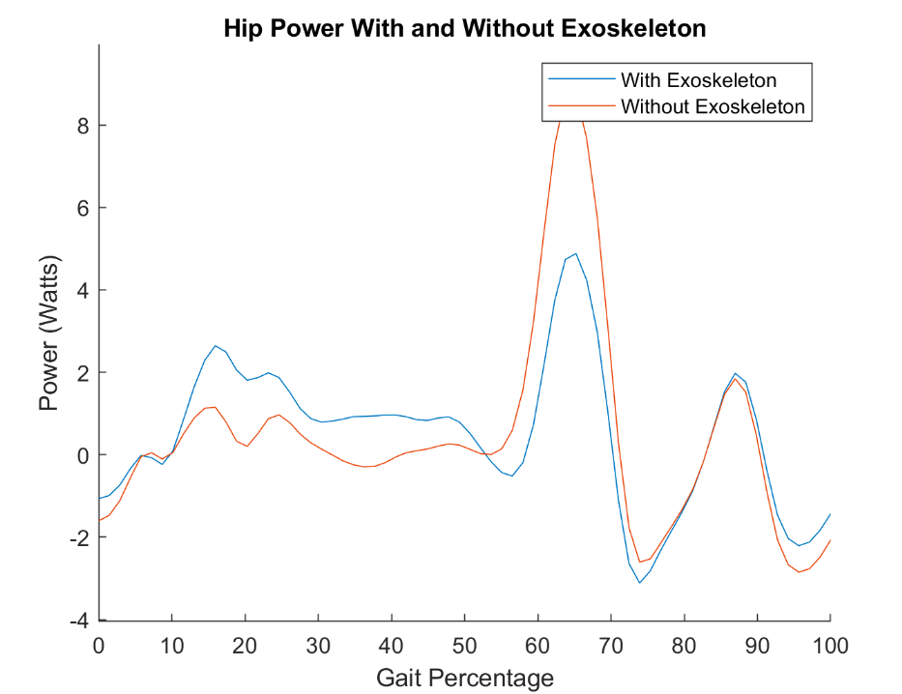
Introduction
Design Criteria
Discussion & Next Steps
Results
Design
Hip Power Results
Energy Harvested during stance phase
1.4 Watts required from the user
Less power required during Swing phase (Flexion Assist)
Assist 46% of hip power

Slide 15
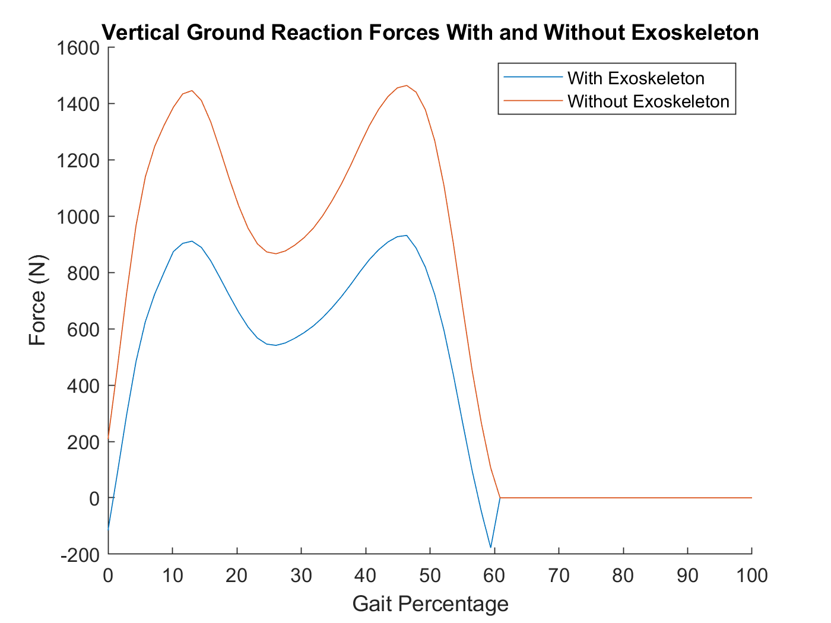
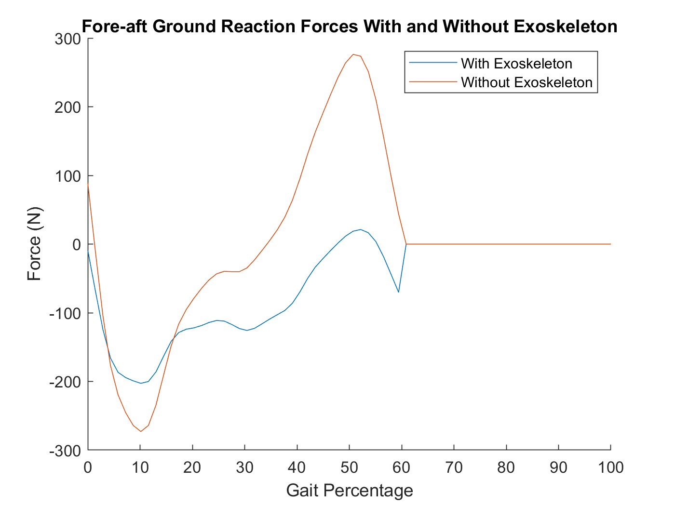
Introduction
Design Criteria
Discussion & Next Steps
Results
Design
Ground Reaction Forces Results
Notes:
GRF
The exoskeleton is designed to support 100% of the weight which is to say the user’s backpack straps should be worn loosely. They will function only to help balance the weight of the backpack
The exoskeleton results in a mean reduction in vertical GRF due to the backpack weight of 94% during stance phase with a maximum of 119%
An analysis of the vertical GRFs leads to 2 conclusions: there are points throughout gait where the exoskeleton reduces the GRFs due to the weight of the user. AND the exoskeleton exceeds the design criteria of reducing the vertical GRFs caused by backpack weight by 50%.
Unfortunately, is does not fully augment the walking endurance of the soldier. The exoskeleton does impede forward propulsion by applying a significant breaking force
This short coming will need to be address in future versions of the exoskeleton by investigating the aspects of the design that could be causing this issue

Slide 16
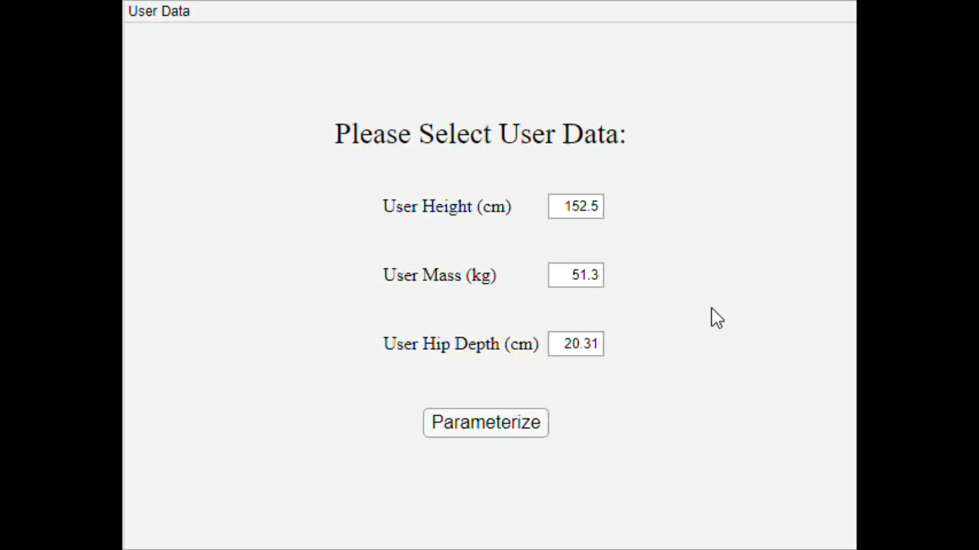
Introduction
Design Criteria
Design
Discussion & Next Steps
Results
Parameterization

Slide 17
Introduction
Design
Discussion & Next Steps
Results
Design Criteria
Future Works
Research other kinds of assist for different joints
Ankle plantar flexion assist
Consider other activities, such as squatting, running, prone and kneeling
Prototyping and testing
Improve user's comfort
Notes:
Shorten focus on the main points

Slide 18
Introduction
Design
Discussion & Next Steps
Results
Design Criteria
Conclusion
Ex.IO can carry a load of 50 kg & results in a mean reduction in the vertical ground reaction forces due to the backpack of approximately 94%
Assists hip flexion
It possesses multiple DOFs
2 DOFs at the hip
1 DOF at the knee
1 DOF at the ankle
It is customizable to male and female infantry soldiers ranging from 153.5 cm to 187 cm
Notes:
-Succeeds in its primary objective as a weight assist exoskeleton *read first point*
-Also succeeds in its secondary objective as a stride assist exoskeleton by assisting hip flexion

Slide 19

Thank you! Questions?

Slide 20

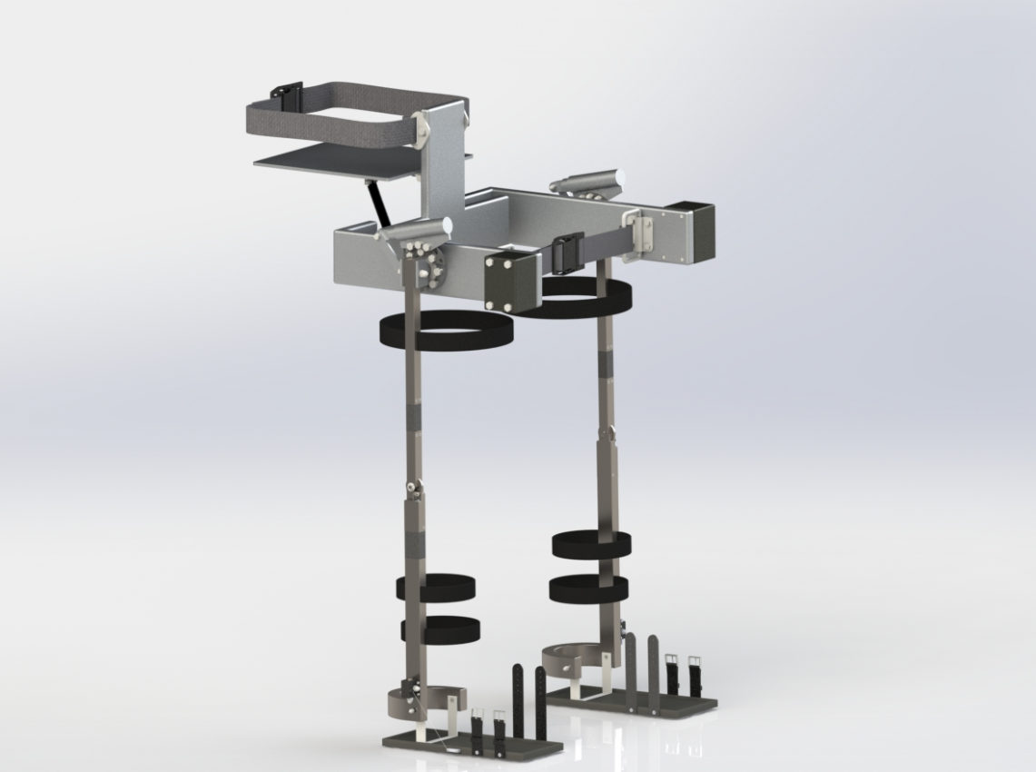
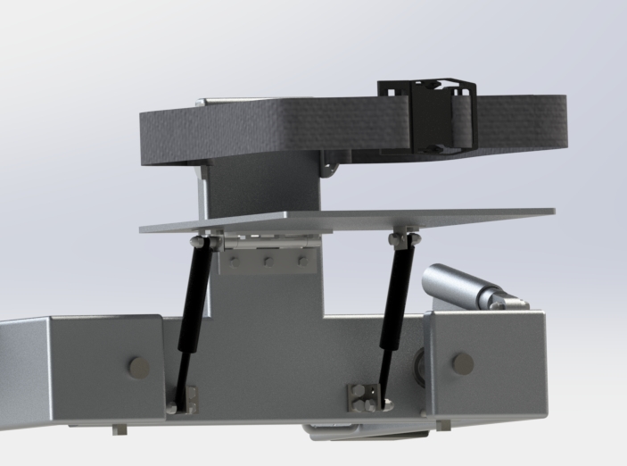
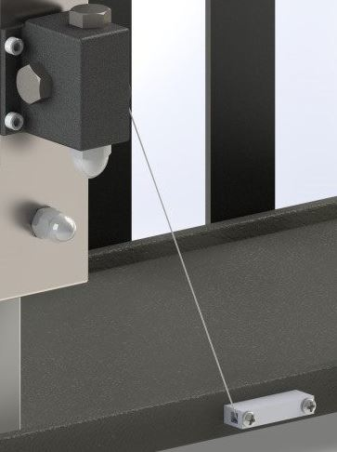

Ex.IO
Objective
Load Carrying System
Create a passively-powered exoskeleton capable of transferring load to the ground
Carry load up to 50 Kg
Mostly made from Aluminum alloy
Target Users
Made for male and female infantry soldiers aged 21-25
Height limited to 152.5 cm to 187 cm
Knee System
Ratchet and pawl lock and unlock knee using a string attached to the foot
Made from steel and cast iron
Abduction/Adduction System
Limit hip Adduction to 10°
Free range of abduction motion
Made from Aluminum alloy and steel alloys
Ankle System
Pin joint allows for 1 DOF:
plantarflexion/dorsiflexion
Transfers load from leg of exoskeleton
to the ground
Flexion Assist System
Assist 10% of hip moment
Linkage mechanism
Rotational to linear movement
By Jennifer Nguyen, Sharon Tam, Megan Vandermolen, Matthew Choi and Huong Pham

Slide 21
References
[1] “HULCTM | Berkeley Robotics & Human Engineering Laboratory.” [Online]. Available: https://bleex.me.berkeley.edu/research/exoskeleton/hulc/. [Accessed: 12-Sep-2019].
[2] “Mawashi Science & Technology - Exosquelette tactique Uprise*MC.” [Online]. Available: http://www.mawashi.net/fr/exosquelette-tactique-uprise. [Accessed: 14-Sep-2019].
[3]C. J. Walsh, K. Endo, and H. Herr, “A QUASI-PASSIVE LEG EXOSKELETON FOR LOAD-CARRYING AUGMENTATION,” Int. J. Humanoid Robot., vol. 04, no. 03, pp. 487–506, Sep. 2007.

